Slide 1
Database Project: Phase I
By Erik Peavey, Gabriel Arizmendi

Slide 2

System Concept
Our initial concept for our project system is a hypothetical basic social media platform. Users can log onto the site using their Username and Password, and can create, like and reply to posts, and follow other users.

Slide 3


Example
Posts can have tags which group them up with posts of a similar topic, and can additionally mention other users, which will notify them of the post. Posts also have a number ID used in the link, and keep track of the date they were created upon.
From @user
This is a sample post for my social media demo!
125
#sampletag
#other-sample-tag
This is a reply to the post
from @other-user
This is a reply to the post... 2!
from @other-user

Slide 4
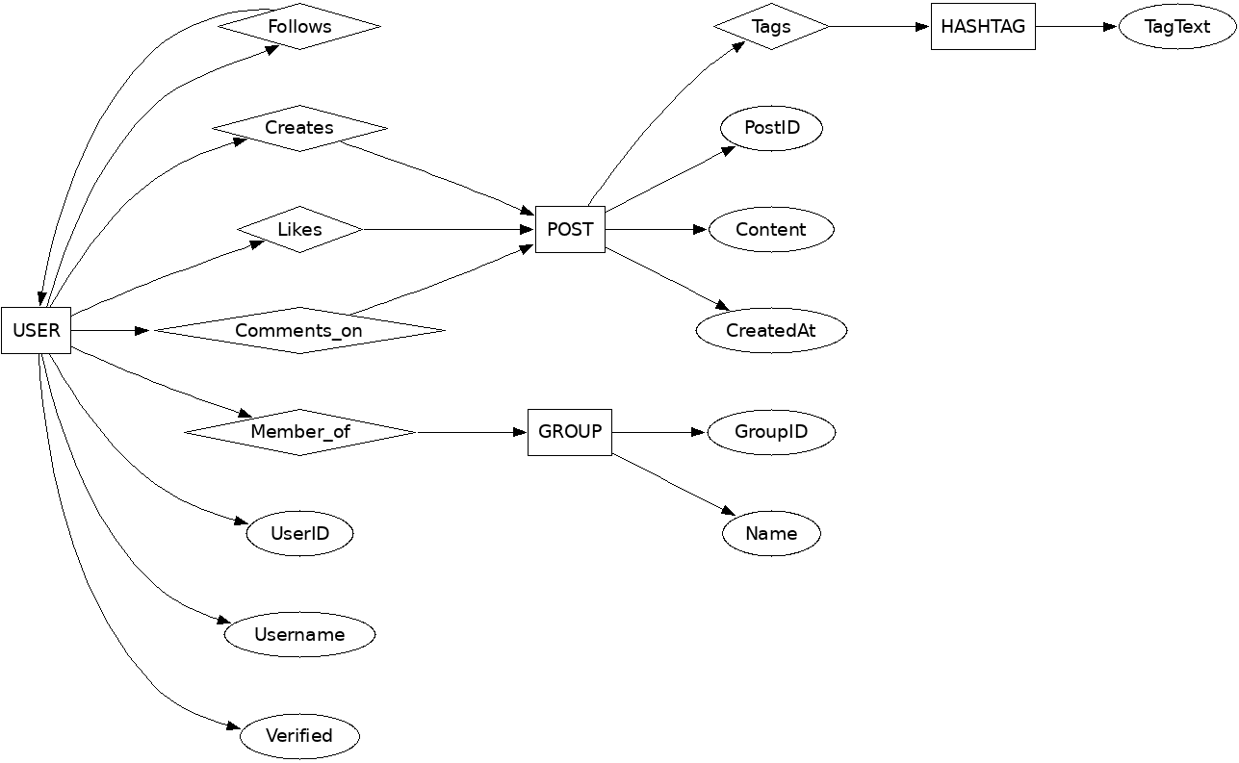
ER Diagram

Slide 5

Queries
Some potential queries we will be implementing for our database:
"Following" tab: return posts of users that a given user is following all in chronological order for a feed-style display.
"Trending" tab: return most liked posts within a certain time threshold
"Friends": return list of mutual followers for a given user (list of users that the user is following that are following them back.)

Slide 6
Technology Choice
For our frontend: HTML, CSS, JavaScript,
For our Vizualization: D3.js
For our backend: Python(flask) with MySQL-Connector-python,
For our database: MySQL

Slide 7


Project Timeline
3/3/26: Phase I Presentation. Complete initial conceptualization for project and the nodes needed for the database design. Set up GitHub repository
3/8/26: Finalize Phase I report
3/26/26: Phase II Presentation. Initial database backend draft and design completed
4/21/26: Phase III Presentation. Basic prototype for platform with basic, limited post and user account viewer frontend
5/7/46: Phase IV Presentation. Final demo of website and completed architecture w/ final report

Slide 8
The End
Thanks for your time!

